Slide 1

Introduction
KeyKiosk.
Members:
Date 13 Month 04 Year 2024
1. | Nguyễn Tiến Đạt | Student1477469
2. | Nguyễn Thanh Hậu | Student1477167
3. | Phạm Tuyên | Student1477478
4. | Nguyễn Hoàng Thái | Student1479454
1

Slide 2
Content
Introduction
Actual requirements
Requirements of the project
Deployment diagram
Test result
Conclusion and development
Task list
2

Slide 3
Introduction - Actual requirements
In the digital era, the landscape of online services and entertainment platforms has expanded significantly, leading to increased demand for account-based trading. This trend has fueled interest in developing software solutions that support account management across various platforms such as Netflix, Spotify, Zoom, and even AI chat services such as ChatGPT.
The current challenge revolves around creating a software solution called "KeyKiosk", designed to facilitate secure and efficient account management. This requires the development of a JavaFX application that provides users with a platform to manage accounts for various online services.
3

Slide 4
Introduction - Requirements of the project
Functional
1. Provide function to store products data into database.
2. Provide information about the products for customers.
3. Seller can makes customer’s orders.
4. Manage Sellers, orders, products information.
5. Business statistics and sellers.
4

Slide 5
Introduction - Requirements of the project
Non - functional
- Usability,
- Speed and Smooth,
- Security and Safety
- Compatibility
5

Slide 6
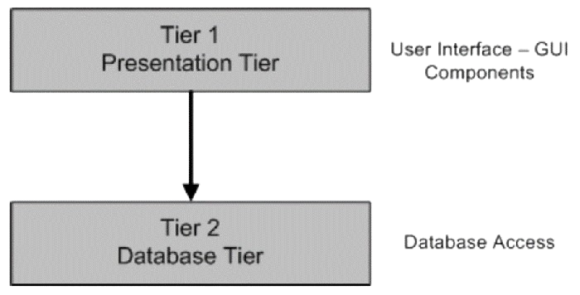
Introduction - Deployment diagram
6

Slide 7
Test Result [1-n]
1. Seller Profile Management OK
2. Seller and Admin Management OK
3. Connection and Order Management OK
4. Product and Equipment Management OK
5. Invoice and Payment Management OK
6. Search and Query OK
7. Login Interface and Access Rights OK
8. Information Security OK
7

Slide 8


Conclusion
Application will help user automate everything, making their work easier for user.
8

Slide 9

Development
Building by JavaFX
9

Slide 10
Task List
No | Customer | Contents |  | Table Name
1 | Nguyễn Thanh Hậu | Admin | Account | Accounts, Categories
2 |  |  | Category
 |  |  | Category
3 |  | Seller | Register
4 |  |  | Login
1 | Nguyễn Tiến Đạt | Admin | Product | Products, Orders
2 |  |  | Order
 |  |  | Order
3 |  | Seller | Product
4 |  |  | Order
1 | Phạm Tuyên | Admin | Software Account | Software Account
2
 |  |  | Profile
3 |  | Seller | Software Account
4 |  |  | Profile
1 | Nguyễn Hoàng Thái | Admin | Dashboard | Software License Keys
2 |  |  | Software License Keys
3 |  | Seller | Dashboard
4 |  |  | Software License Keys
10

Slide 11

Thank You
11

Slide 12

Reference
Aptech course
12

